Slide 1
Project Introduction Analysis of driving behavior
Spring semester, 2019-2020
Shuyan Chen
Yongfeng Ma

Slide 2
outline
Data description
Basic information ( including why/ when/ Where to collect data?)
Data dictionary (what kind of data are collected? Introduce each attribute, including each attribute’s meaning, value, range…)
Task description (What to do? How to do?)
What problem to solve? What model to build? What relationship to find?...

Slide 3
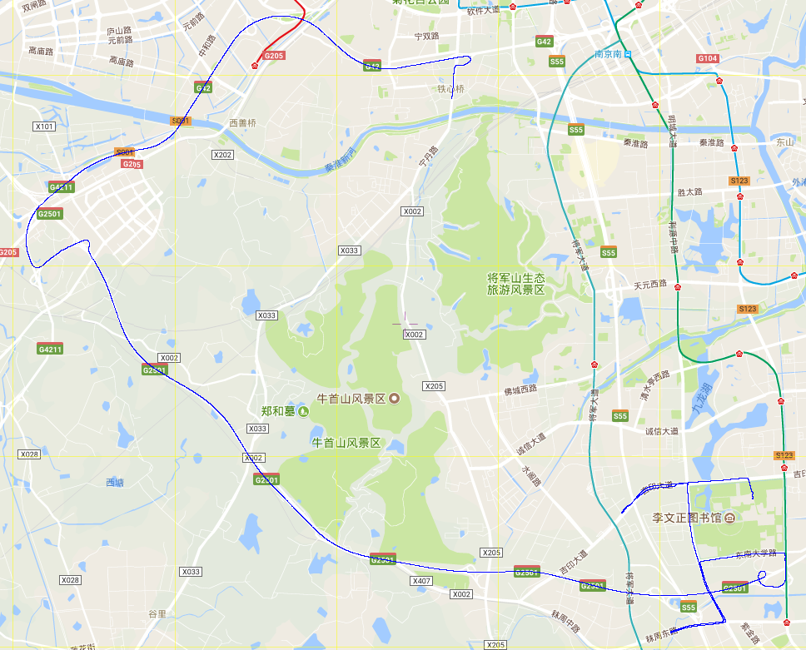
Data description
Purpose: to study the abnormal driving behavior
Collected data from an V-BOX running on a car with 1 driver in Nanjing on 2018-05-08.
Where to collect: detailed_map.png give the details of the vehicle's trajectory. The starting point of the trajectory is located in the Jiulonghu Campus of Southeast University.
Save as abnormal_events.csv and VBOX.csv
abnormal_events.csv
records the time and duration of the abnormal behaviors,
contains two attributes and 70 abnormal events.
VBOX.csv
contains 15 attributes and 51546 records.
The sampling frequency is 10Hz.

Slide 4
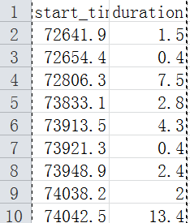
abnormal_events.csv:
start_time: the moment when the abnormal driving event occurred. This attribute corresponds to the attribute “time” in VBOX.csv
duration: the duration of the driving event (s)
Abnormal driving behavior lasting 1.5 seconds ( i.e. 15 records ) from time 72641.9 ( corresponding to the time column in the VBOX.csv ), that is, samples with the time from 72641.9 to 72643.4.

Slide 5
VBOX.csv:
sats: Number of satellites
time: GPS UTC timestamp (s)
long: longitude
lat: latitude
velocity (km/h)
heading: the heading angle of the vehicle (degree)
height: altitude (m)
vert-vel: vertical velocity (km/h)
GPS-Longacc: GPS longitude acceleration (m/s²)
turn-radius: turning radius (m)
Centre-Line-Deviation: Distance to road centerline
AbsHead: the absolute heading angle of the vehicle (degree)
Longacc: longitude acceleration (g)
Latacc: latitude acceleration (g)
rel-height: height relative to the start point (m)
Note:
There are a lot of valueless data in VBOX.csv. These valueless data should be cleaned before the data processing.
What kind of data is valueless?
All attribute values are the same
Classification variables with different values in all samples
Etc.
If abnormal_events.csv was been used, it will be necessary to up-sample or down-sample the data to ensure that the ratio of positive samples to negative samples is between 2: 1 and 1: 2.
What’s up-sample or down-sample?
More attention should be paid to the accuracy and recall of the abnormal events (rather than normal driving behaviors).

Slide 6
Task 1 - Detect Abnormal Driving Behavior with Unlabeled Data
Tasks: In this driving behavior dataset, the driver did some abnormal behaviors. The objective of this task is to detect whether the driver is in an abnormal state according to the dataset. In this task, all the data you can use in training should come from VBOX.csv, which means you can only use the abnormal_events.csv once.
Steps:
Step 1 Data cleaning and feature selection: use appropriate screening methods and rules to deal with missing values, select valuable features, remove features that are highly correlated, unimportant or have unique attributes ( such as timestamps ), and reduce dimensions ( not always necessary )
Step 2 To verify the accuracy of the model established, the measured data should be divided into training set and test set. The training set is used to build the model, and the test set is used to verify the accuracy of the model.
Step 3 Modeling and analysis: Using an unsupervised algorithm ( like GMM, clustering, etc. ) to predict the time that the abnormal driver behavior occurred.
Step 4 After detecting an abnormal event, compare it with what is described in abnormal_event.csv to get the performance of the model. Apply some metrics ( Recall, Precision, F₁-score, etc. ) to compute the performance of the result. Note: abnormal_event.csv can only be used for the result validation.
Note:
Different types of algorithms are available: such as Anomaly Detection Algorithms, Clustering Algorithms, etc.
For clustering algorithms: The purpose of this task is to determine whether driving behavior is abnormal, but this does not mean that you can only cluster the data into two categories since there may be many kinds of driving behavior.
It is normal that the results of unsupervised algorithms will be much worse than those of supervised algorithms.
After completing the Task, you need to choose to discuss Task 3 or Task 4.

Slide 7
Task 2 - Predict Abnormal Driving Behavior with Labeled Data
Tasks: In this driving behavior dataset, the driver did some abnormal operations during driving. The objective of this task is to predict whether the driver is in an abnormal state according to the vehicle motion data. The abnormal_events.csv file contains the time and duration of events marked as exceptions. The information in the abnormal_events.csv should be linked to VBOX.csv through time.
Steps:
Step 1 Data cleaning and feature selection: use appropriate screening methods and rules to deal with missing values, select valuable features, remove features that are highly correlated, unimportant or have unique attributes ( such as index ), and reduce dimensions ( if necessary )
Step 2 To verify the accuracy of the model established, the measured data should be divided into training set and test set. The training set is used to build the model, and the test set is used to verify the accuracy of the model.
Step 3 Modeling and analysis: Apply a supervised algorithm to predict the abnormal driver behavior by using vehicle motion data ( At this point, you need to add the event as a label to the dataset ). Or use unsupervised methods to identify abnormalities in driving.
Step 4 Use the test set to verify the performance of the model. Apply some metrics ( Recall, Precision, F₁-score, etc. ) to compute the performance of the result.
Note:
After completing the Task, you need to choose to discuss Task 3 or Task 4.

Slide 8
Task 3 - Driving Behavior Analysis of Multiple Drivers
Tasks: Assuming that there are multiple driver data, each driver has multiple experimental data (including road traffic characteristics, etc. ). Give further detailed ideas for analyzing abnormal driving behavior. This task is open-ended. The purpose of the task is to describe the main ideas, algorithms used and problems to be solved for analyzing the driving behavior of multiple drivers. In particular, what is the difference between multi-driver and single-driver driving behavior analysis should be emphatically analyzed.

Slide 9
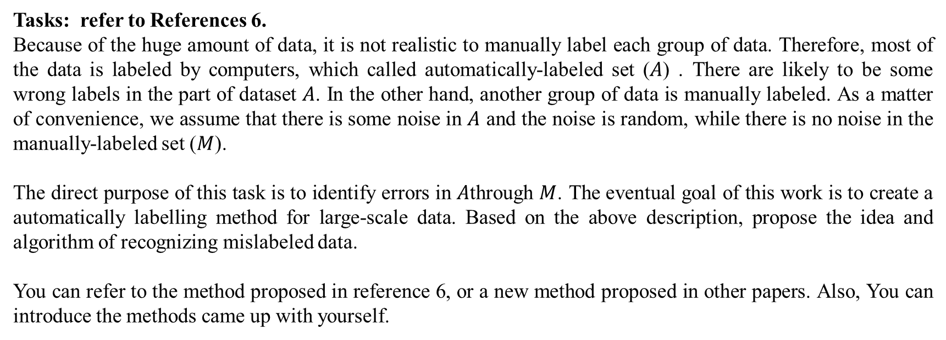
Task 4 - Recognize the mislabeled data in the driving behavior dataset
Tasks: refer to References 6.
Because of the huge amount of data, it is not realistic to manually label each group of data. Therefore, most of the data is labeled by computers, which called automatically-labeled set ($A$) . There are likely to be some wrong labels in the part of dataset $A$. In the other hand, another group of data is manually labeled. As a matter of convenience, we assume that there is some noise in $A$ and the noise is random, while there is no noise in the manually-labeled set ($M$).
The direct purpose of this task is to identify errors in $A$through $M$. The eventual goal of this work is to create a automatically labelling method for large-scale data. Based on the above description, propose the idea and algorithm of recognizing mislabeled data.
You can refer to the method proposed in reference 6, or a new method proposed in other papers. Also, You can introduce the methods came up with yourself.

Slide 10
Reference
Rodriguez Gonzalez, A. B., M. R. Wilby, J. J. Vinagre Diaz, and C. Sanchez Avila. Modeling and Detecting Aggressiveness from Driving Signals. IEEE Transactions on Intelligent Transportation Systems, Vol. 15, No. 4, 2014, pp. 1419–1428. https://doi.org/10.1109/TITS.2013.2297057.
Júnior, J. F., E. Carvalho, B. V. Ferreira, C. De Souza, Y. Suhara, A. Pentland, and G. Pessin. Driver Behavior Profiling: An Investigation with Different Smartphone Sensors and Machine Learning. PLoS ONE, Vol. 12, No. 4, 2017, p. e0174959. https://doi.org/10.1371/journal.pone.0174959.
Khushaba, R. N., S. Kodagoda, S. Lal, and G. Dissanayake. Driver Drowsiness Classification Using Fuzzy Wavelet Packet Based Feature Extraction Algorithm. Biomedical Engineering, IEEE Transactions on, Vol. PP, No. 99, 2010, p. 1.
Ersal, T., H. J. A. Fuller, O. Tsimhoni, J. L. Stein, and H. K. Fathy. Model-Based Analysis and Classification of Driver Distraction under Secondary Tasks. IEEE Transactions on Intelligent Transportation Systems, Vol. 11, No. 3, 2010, pp. 692–701. https://doi.org/10.1109/TITS.2010.2049741.
Liang, Y., M. L. Reyes, and J. D. Lee. Real-Time Detection of Driver Cognitive Distraction Using Support Vector Machines. IEEE Transactions on Intelligent Transportation Systems, Vol. 8, No. 2, 2007, pp. 340–350. https://doi.org/10.1109/TITS.2007.895298.
Northcutt, C. G., Wu, T., & Chuang, I. L. (2017). Learning with Confident Examples: Rank Pruning for Robust Classification with Noisy Labels, (1). Retrieved from http://arxiv.org/abs/1705.01936

